Slide 1
Data Visualization Workflows

Slide 2
Michael Bowman
Director of Engineering at Mile Two
Adjunct at Sinclair
Dayton Data Visualization… ?

Slide 3

We’re Hiring!

Slide 4
Data Visualization Workflows
It takes *many* different tools to do Data Visualization
Examples online are trivial or standalone
No “right” way… just some examples of how I have done things at least once…
Notes:
If you took some numbers and turned them into a graphic, congrats, you did data visualization!
I rarely do things the same way twice
Like web development, always be learning and adopting new tools

Slide 5

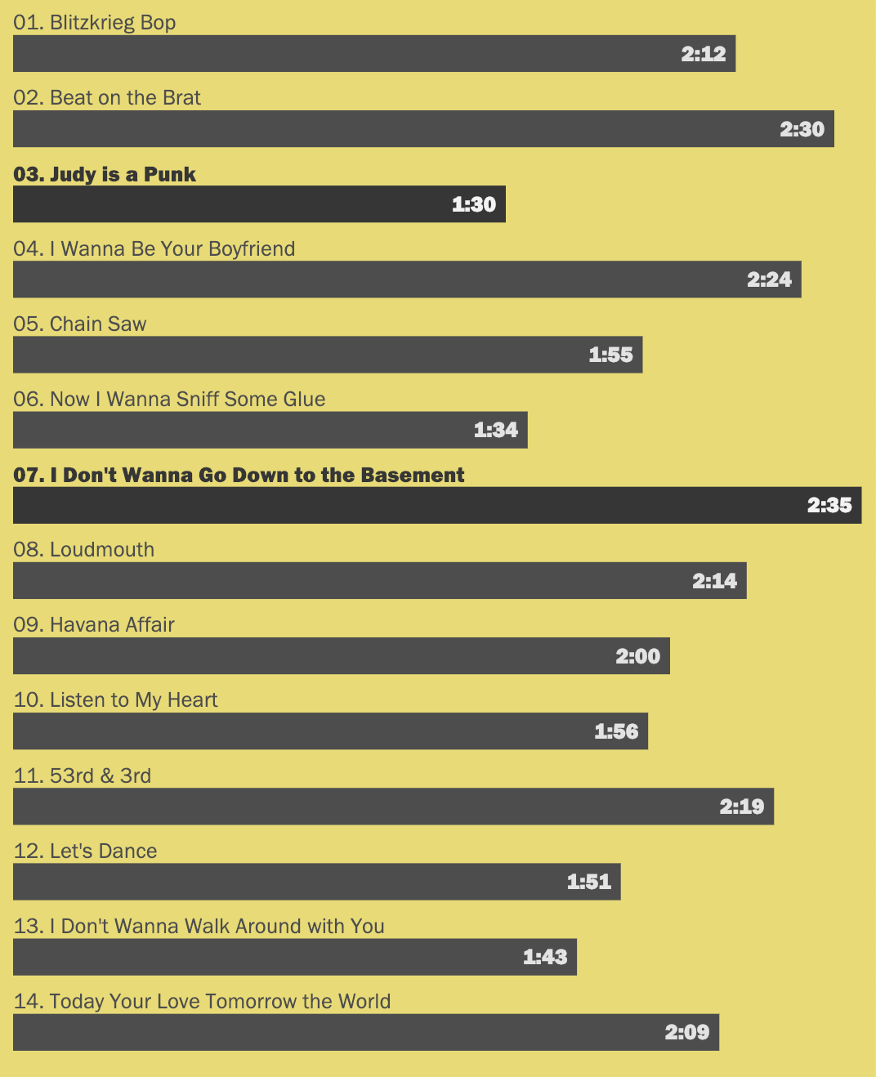
01. BAR CHART
Notes:
For our first visualization, we’ll be charting song lengths from the first Ramones album.
Released in 1976
One of the most influential records ever made

Slide 6
WORKFLOW
1. Exploring with Tableau
2. Prototyping with D3
3.
Production with React
Notes:
Here’s a typical workflow I use on projects.
First step is to explore the data and see what kind of story is there. Is there any type of chart that lends itself well to the data? Tableau is a great tool for data exploration that will allow you to quickly tryout a bunch of different charts.
The second step is to prototype things out with D3 and CodePen
Final step is to move everything to React and create some components

Slide 7
Track | Title | Length (seconds) | Length (human-readable)
01 | Blitzkrieg Bop | 132 | 2:12
02 | Beat on the Brat | 150 | 2:30
03 | Judy is a Punk | 90 | 1:30
04 | I Wanna Be Your Boyfriend | 144 | 2:24
05 | Chain Saw | 115 | 1:55
06 | Now I Wanna Sniff Some Glue | 94 | 1:34
07 | I Don't Wanna Go Down to the Basement | 155 | 2:35
08 | Loudmouth | 134 | 2:14
09 | Havana Affair | 120 | 2:00
10 | Listen to My Heart | 116 | 1:56
11 | 53rd & 3rd | 139 | 2:19
12 | Let's Dance | 111 | 1:51
13 | I Don't Wanna Walk Around with You | 103 | 1:43
14 | Today Your Love Tomorrow the World | 129 | 2:09
Notes:
Here’s our data, a CSV file containing fourteen rows with the track number, song title, and length both in seconds and in a human readable format.

Slide 8
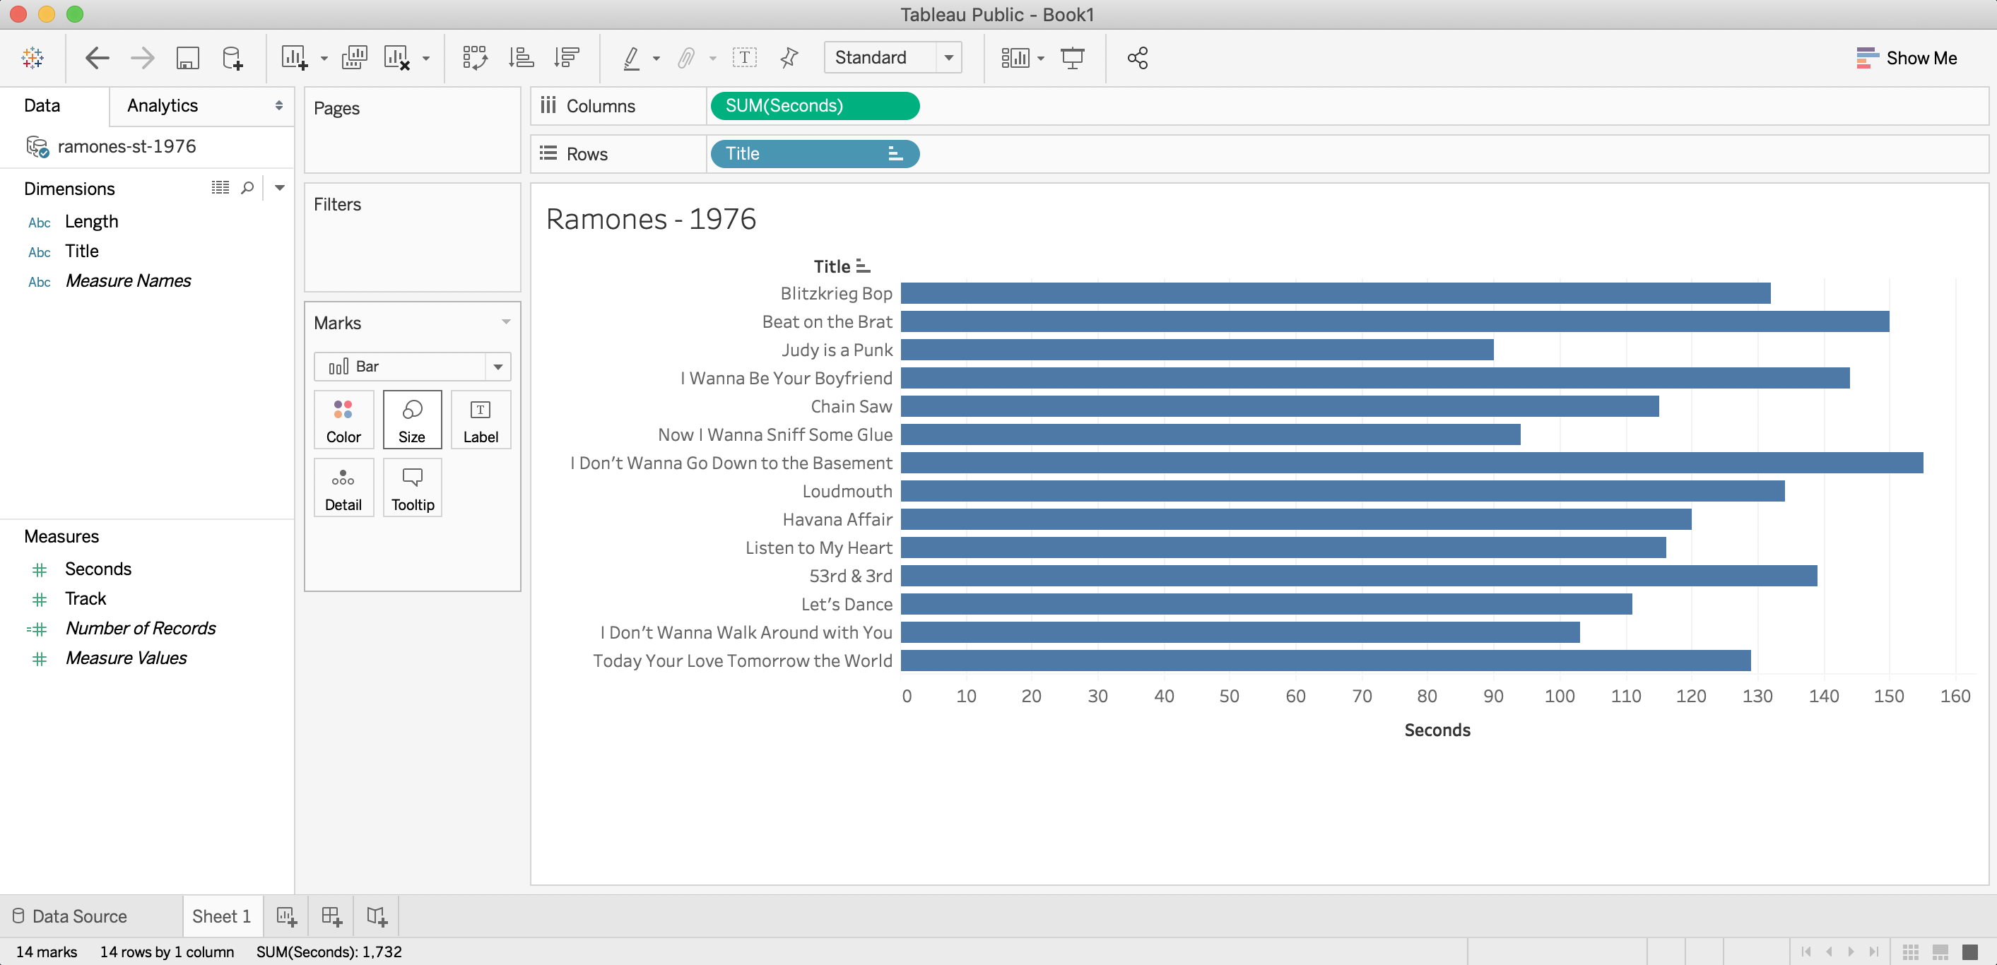
PROTOTYPING WITH TABLEAU
Tableau Public – free!
Notes:
A good way to quickly investigate a dataset is to through it into tableau
You can quickly flip through different visualizations
A very complex and capable data visualization tool. For lots of people, this is their only tool.

Slide 9
PROBLEMS TO ADDRESS
Too Wide for Mobile
Seconds vs Length
Storytelling
Notes:
Now that we’ve got an idea of what the data looks like, let’s think about ways to improve the design
Bar Chart is still good, but the label placement makes it hard to read on mobile devices
Would rather have the minutes/seconds label instead of the number of seconds
Highlight the shortest/longest songs (storytelling)

Slide 10

CODING WITH D3
D3 Only Solution https://codepen.io/webslingerm/pen/QJWxXE
Notes:
CodePen for quick code prototypes
d3.fetch() to get the csv file
d3.select().enter().append() to manipulate the DOM
d3.attr() to set element attributes
SHOW CODEPEN AND WALK THROUGH CODE

Slide 11
WHAT ABOUT REACT?
D3 is great, but how do I get that into my React application?
Notes:
This solution is great. It’s close to what we want and looks good on mobile devices
Very close to D3 tutorial code
But there is a lot of manual DOM manipulation
Which parts of that code are “visualization” parts, and which are just jquery?

Slide 12
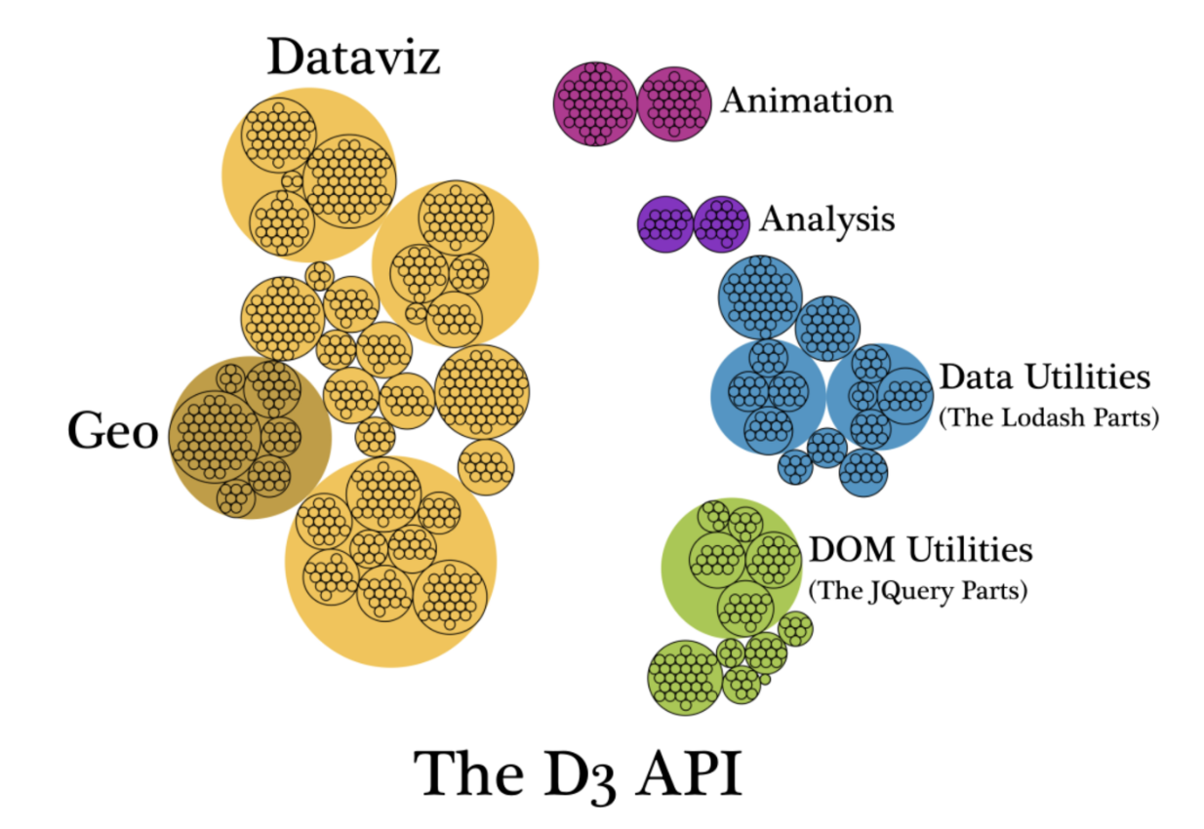
D3 LIBRARY OVERVIEW
From ”D3 is Not a Data Visualization Library” by Elijah Meeks https://medium.com/@Elijah_Meeks/d3-is-not-a-data-visualization-library-67ba549e8520
Notes:
Visualization of D3 parts
d3.fetch(), d3.select(), d3.attr() -> all “jQuery” parts…
This is 90% of the D3 example/tutorial code out there
Which parts do we need if we’re using React/Vue/Angular?

Slide 13
Modular D3
import { csvParse } from ‘d3-dsv’;
const data = csvParse(csvFileContentsAsString);
import { scaleLinear } from ‘d3-scale’; const x = scaleLinear().domain([0,160]).range([0,width]);
import { extent } from ’d3-array’; const extents = extent(data, d => Number(d.Seconds));
Notes:
Look out for these lines
Let React handle the dom bits
Break up d3 code and only import the functions needed for visualization

Slide 14
D3 + REACT
D3 + React Solution
Notes:
SHOW CODEPEN AND WALK THROUGH CODE
Fetch api & templates
Template & props for jQuery stuff
http://localhost:3000

Slide 15
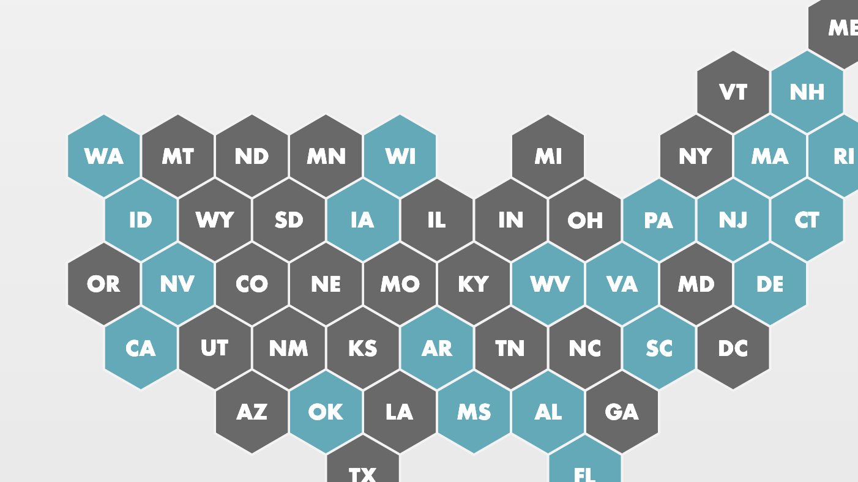
02. Hex Map
Notes:
NPR 1 to 1 – Hex Map

Slide 16
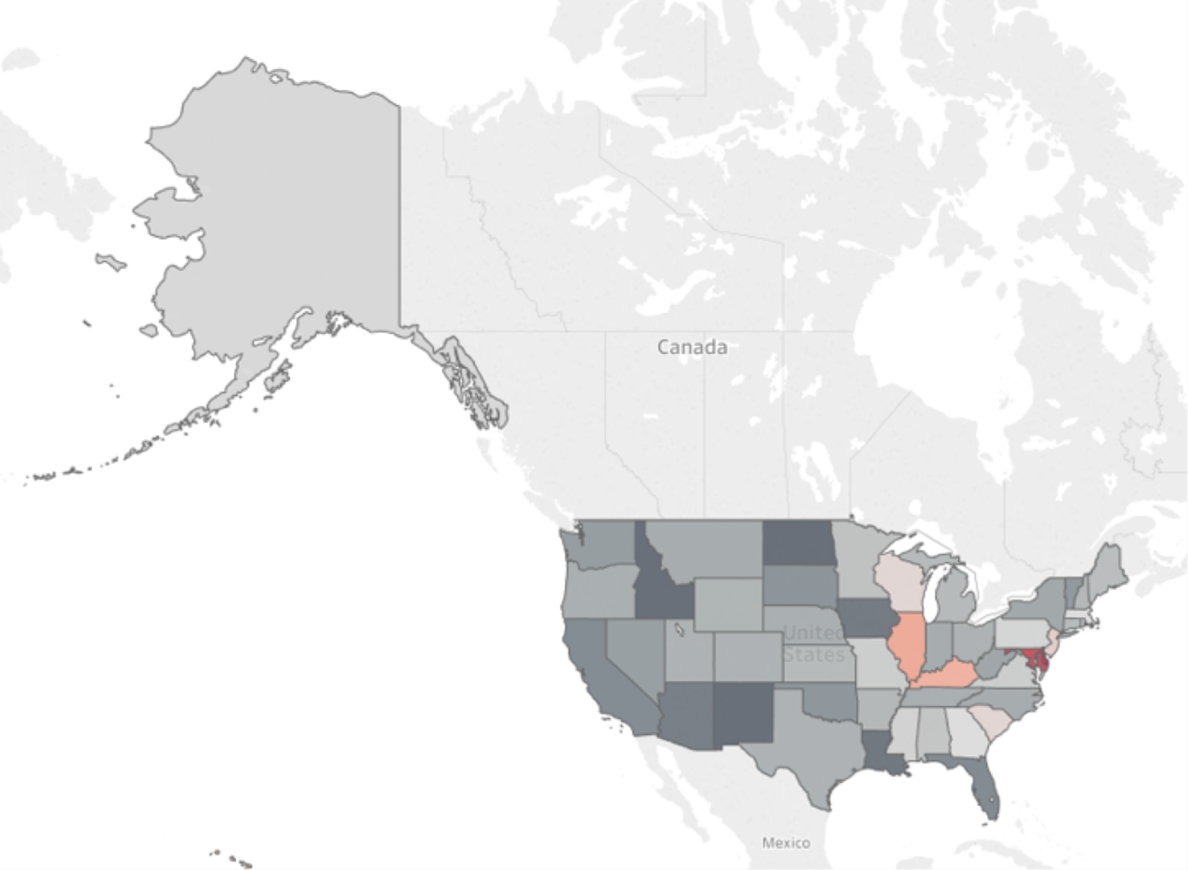
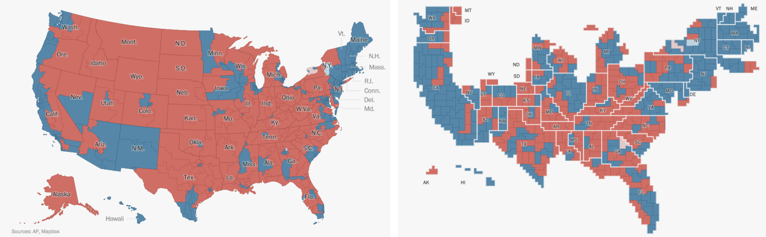
Why?
Notes:
Projections always introduce some sort of distortion into the map
Standard/Default projections warp northern territories

Slide 17
Why?
Notes:
https://www.tableau.com/about/blog/2017/1/viz-whiz-hex-tile-maps-64713
https://blog.mapbox.com/washington-posts-electoral-maps-how-we-built-it-b311ccecfa75
Why?
Election Maps
Elections count votes, not acreage
People still relate to position, so arrange equal sized hexagons into USA shape
2018 House of Representatives election map
Use any time you want to show:
Geo data when users should NOT focus on area
Proportions… how do states relate to one another and the country (but not regarding area)

Slide 18
WORKFLOW
1. Tilegrams & Illustrator
2. SVG OMG
3.
Angular Component

Slide 19
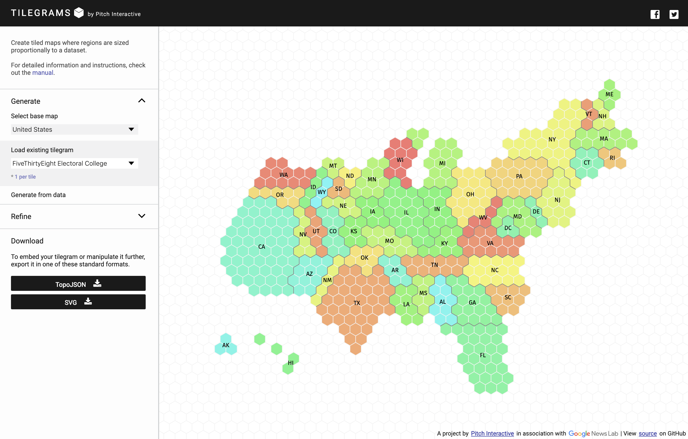
Tilegrams
https://pitchinteractiveinc.github.io/tilegrams
Notes:
Tilegrams - https://pitchinteractiveinc.github.io/tilegrams/
NPR 1 to 1

Slide 20
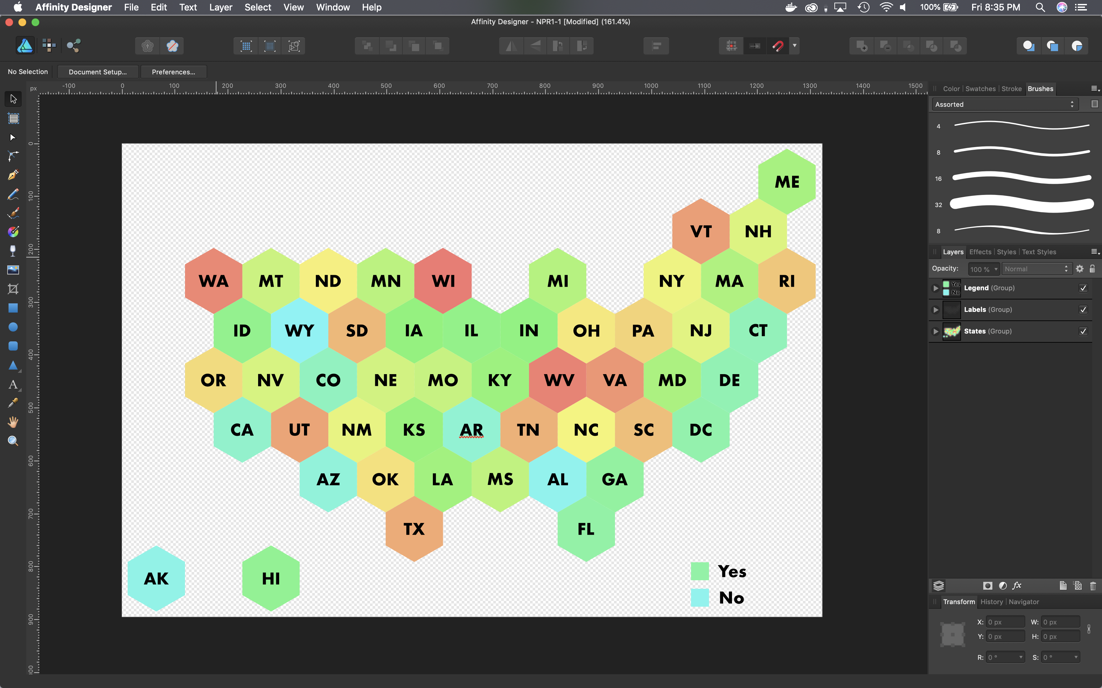
Affinity Designer (Illustrator)
https://affinity.serif.com/en-us/designer/
Notes:
Affinity Designer
Vector Design Tool
One Time Purchase
iPad and Desktop
Adobe Illustrator / Inkscape
Converting SVG output from an illustration program… maybe something you got from your design team…

Slide 21
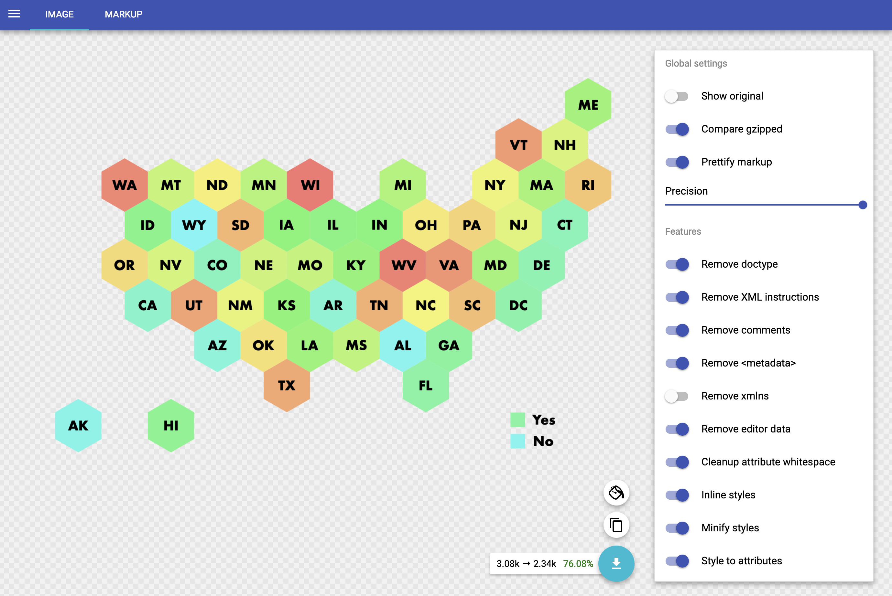
SVG OMG
https://jakearchibald.github.io/svgomg/
Notes:
Web Based GUI for SVGO – command line node.js tool
Jake Archibald – Google Developer
Reduces SVG File size
Cleans up tags and styles
Reduced to 76% of original size (24% reduction) (3.08k -> 2.34k)

Slide 22
Dataset
Code.org
nonprofit dedicated to expanding access to computer science in schools and increasing participation by women and underrepresented minorities.
2018 State of Computer Science Report

Slide 23
Angular & SVG
TypeScript
SVG Component
Notes:
SHOW CODE AND WALKTHROUGH
ViewBox Here
http://localhost:4200

Slide 24
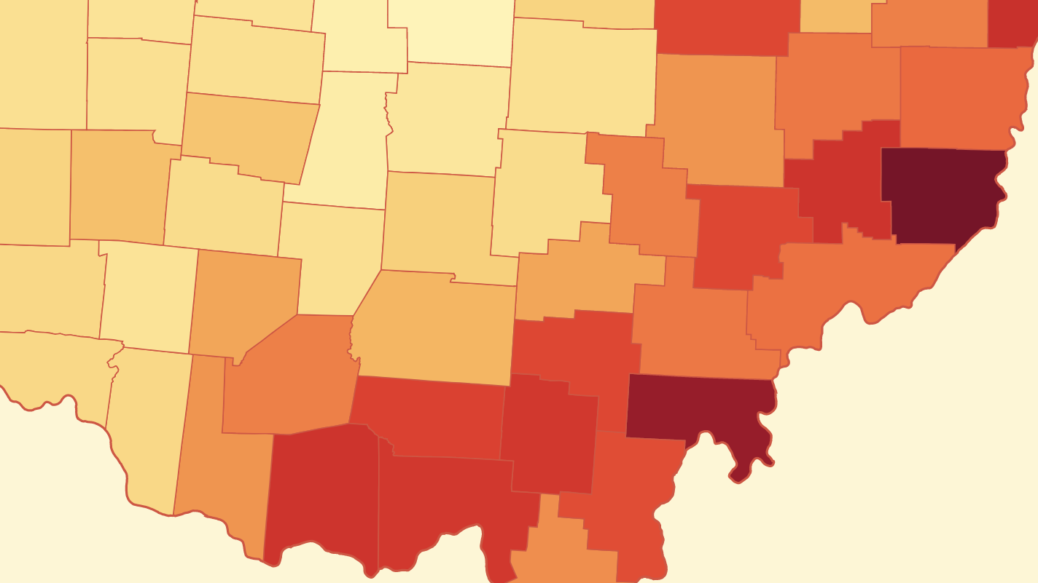
03. Choropleth Map

Slide 25
Choropleth Maps
Thematic map where area is shaded in proportion to some measurement.
Notes:
Very important to normalize your data when doing a choropleth map!
Unemployment data we’ll be using has been normalized already… we’re showing the unemployment *rate* not the # of unemployed

Slide 26
Workflow
1. D3 Example Code
2. Vue Component

Slide 27
Revisiting Some Old D3 Code
Choropleth map I did in 2015
Ohio Unemployment Data
D3 Code is complicated and hard to follow
Notes:
http://bowmanmc.github.io/designing_maps/04_choropleth.html
https://github.com/bowmanmc/designing_maps/blob/master/app/scripts/04_choropleth.js

Slide 28
Vue.js
computed properties
Filter data
Reusable path generator
Notes:
Some things to look for in the vue code
Computed properties are my favorite feature of vue
Use case: filter data
Create dependent attributes or functions

Slide 29
D3.js
d3-dsv – BLS data is tab-delimited
d3-geo – library for creating SVG path elements
d3-scale-chromatic – color scales
Notes:
Two new ones, d3-geo and d3-scale-chromatic
d3-geo – mapping related functions and utilities
Converts geojson into svg path elements
d3-scale-chromatic – continuous color scales

Slide 30

Vue + D3
Notes:
SHOW ORIGINAL D3 CODE ON GITHUB FIRST!!!
SHOW CODE AND WALKTHROUGH
Computed properties
http://localhost:8080

Slide 31
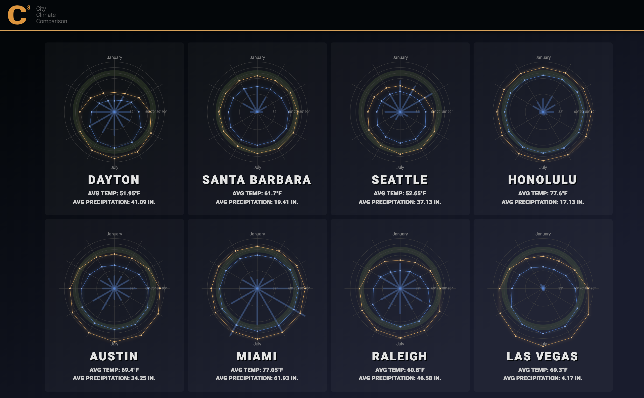
04. Radar Charts
Notes:
Radar Chart

Slide 32
Radial Hate
Data Visualization Literacy
Always use a bar chart?
Notes:
People in the Data Vis community *hate* any type of radial charts
Tufte – only thing worse than one pie chart is multiple pie charts
Radials are hard to compare
DV literacy is horrific
Apple’s Activity Rings
Who is your audience?
Design conundrum… uniqueness vs patterns

Slide 33
Cookie Cutter
Most charting libraries have a radar chart type built-in
Chart.js
React-vis
Plot.ly
Highcharts
Notes:
Most cookie cutter charting libraries have a radar chart type built in…
I thought it would be a good example of how to break up something non-trivial into components

Slide 34
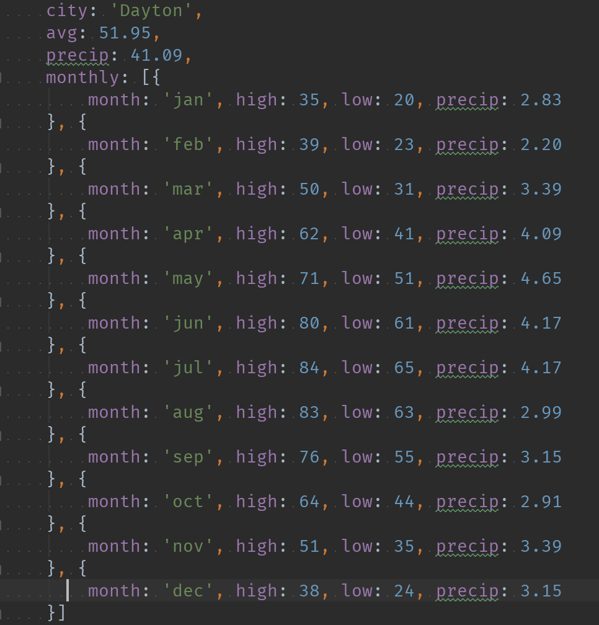
Data
Climate information for various US cities
www.usclimatedata.com
Notes:
Thinking about retirement…
Want something as close to 70 degrees year round as possible
https://www.usclimatedata.com

Slide 35
Workflow
1. Develop
& Tweak
Notes:
Build up, in code, one component at a time

Slide 36
Components
How would you break this up?
Notes:
Ask everyone how they would break this up
No right/wrong answers

Slide 37

Development
Notes:
Built from screenshots as I was developing

Slide 38

Data Visualization Components
React
SVG Components

Slide 39
Thanks Everyone!
https://github.com/bowmanmc/dvworkflows
Notes:
https://github.com/bowmanmc/dvworkflows
Slides will be up soon…

